Slide 1

Amrita – Все для здоров’я та краси
www.amritaclub.do.am
ввввввввввввввввввввввв

Slide 2

www.amritaclub.do.am
ввввввввввввввввввввввв

Slide 3
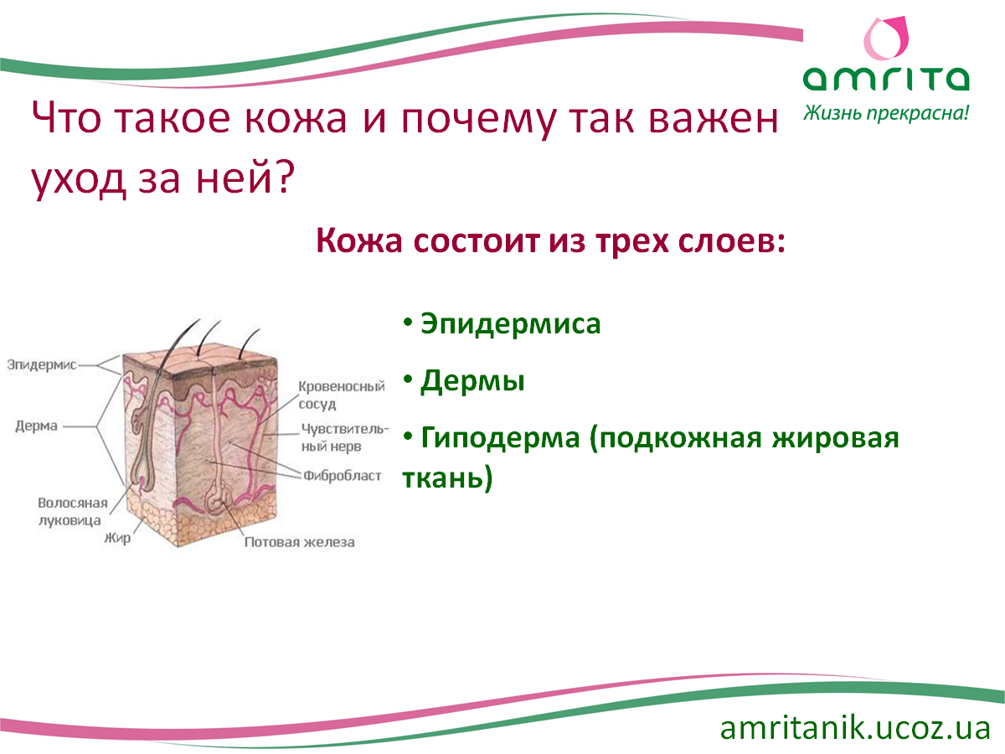
www.amritaclub.do.am
ввввввввввввввввввввввв

Slide 4
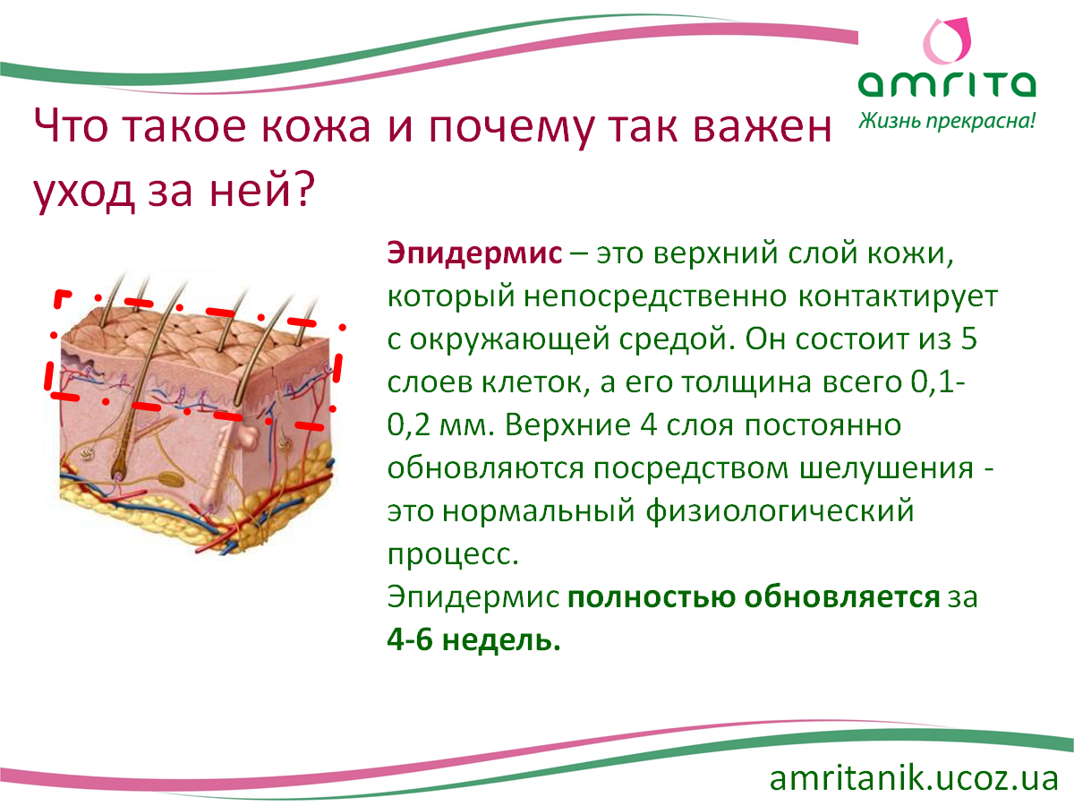
www.amritaclub.do.am
ввввввввввввввввввввввв

Slide 5
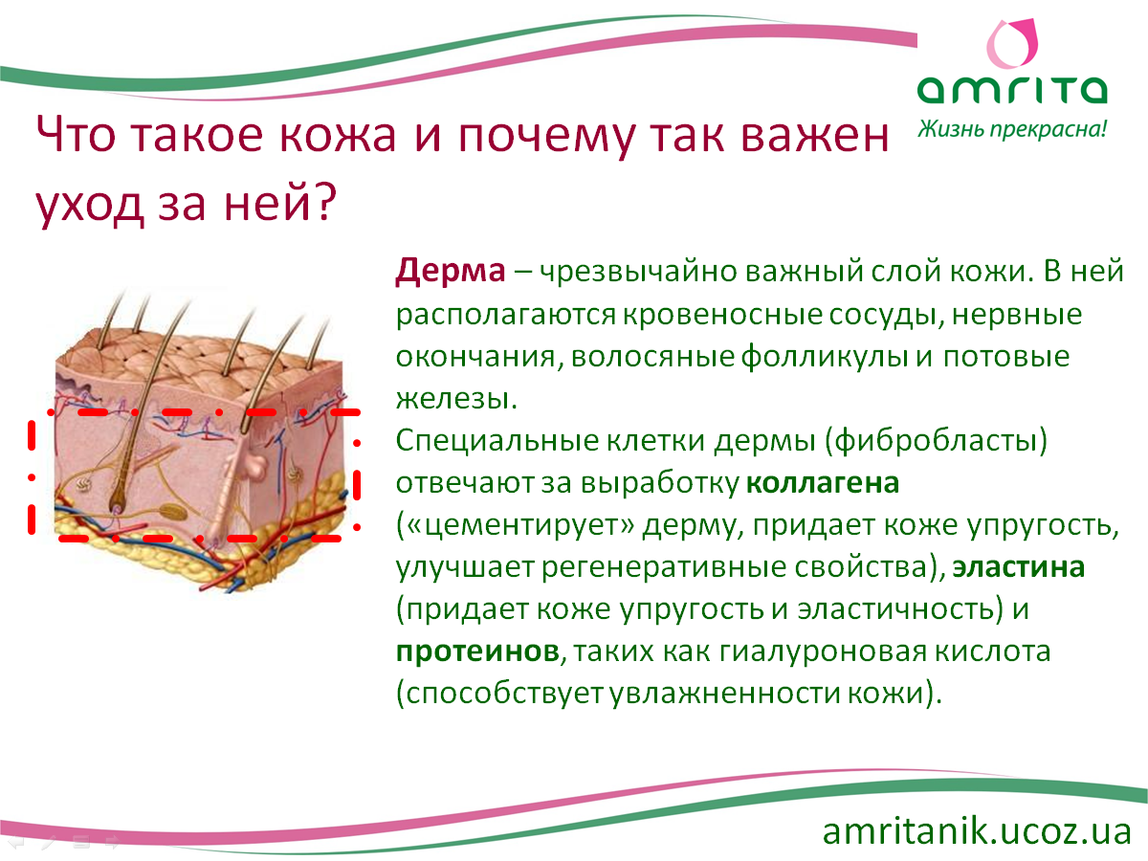
www.amritaclub.do.am
ввввввввввввввввввввввв

Slide 6
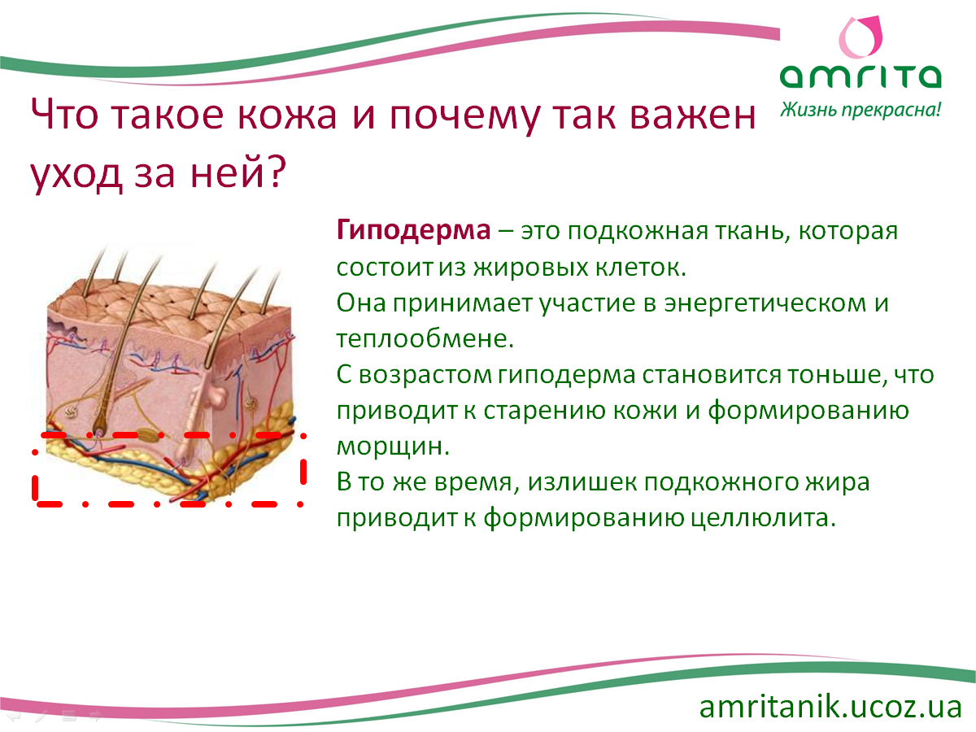
www.amritaclub.do.am
ввввввввввввввввввввввв

Slide 7

www.amritaclub.do.am
ввввввввввввввввввввввв

Slide 8

www.amritaclub.do.am
ввввввввввввввввввввввв

Slide 9

www.amritaclub.do.am
ввввввввввввввввввввввв

Slide 10

ввввввввввввввввввввввв
ввввввввввввввввввввввв
www.amritaclub.do.am
ввввввввввввввввввввввв

Slide 11

www.amritaclub.do.am
ввввввввввввввввввввввв

Slide 12

www.amritaclub.do.am
ввввввввввввввввввввввв

Slide 13

www.amritaclub.do.am
ввввввввввввввввввввввв

Slide 14

www.amritaclub.do.am
ввввввввввввввввввввввв

Slide 15

www.amritaclub.do.am
ввввввввввввввввввввввв

